Slide 1

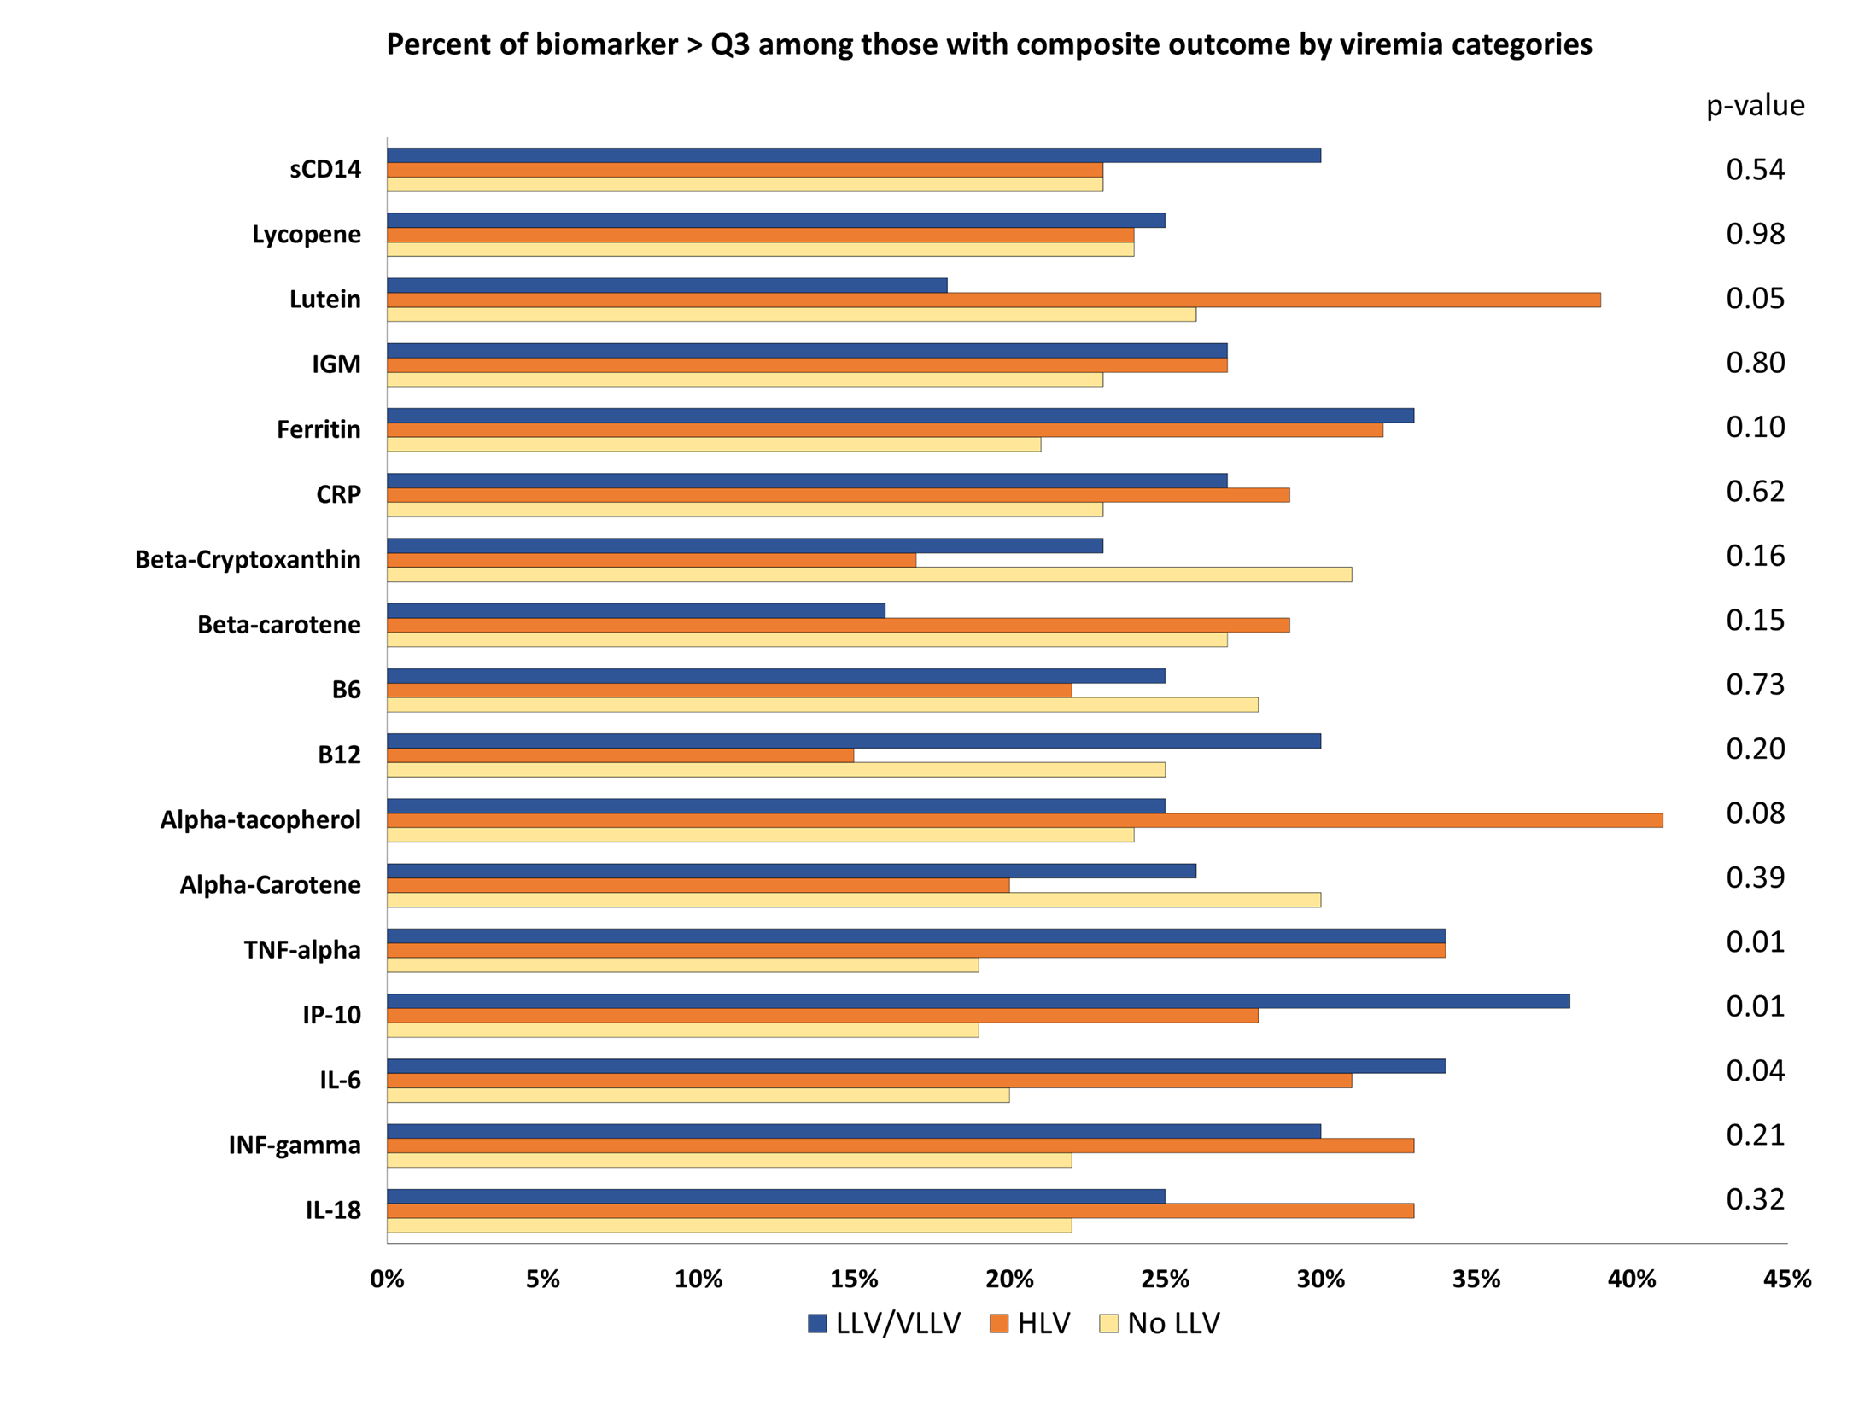
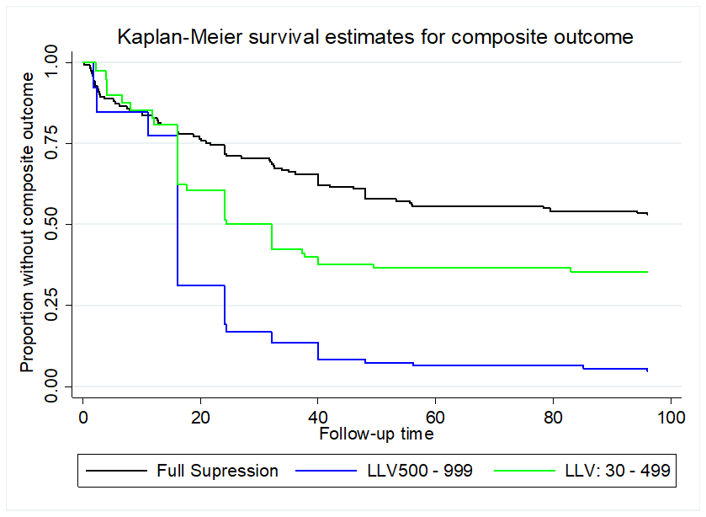
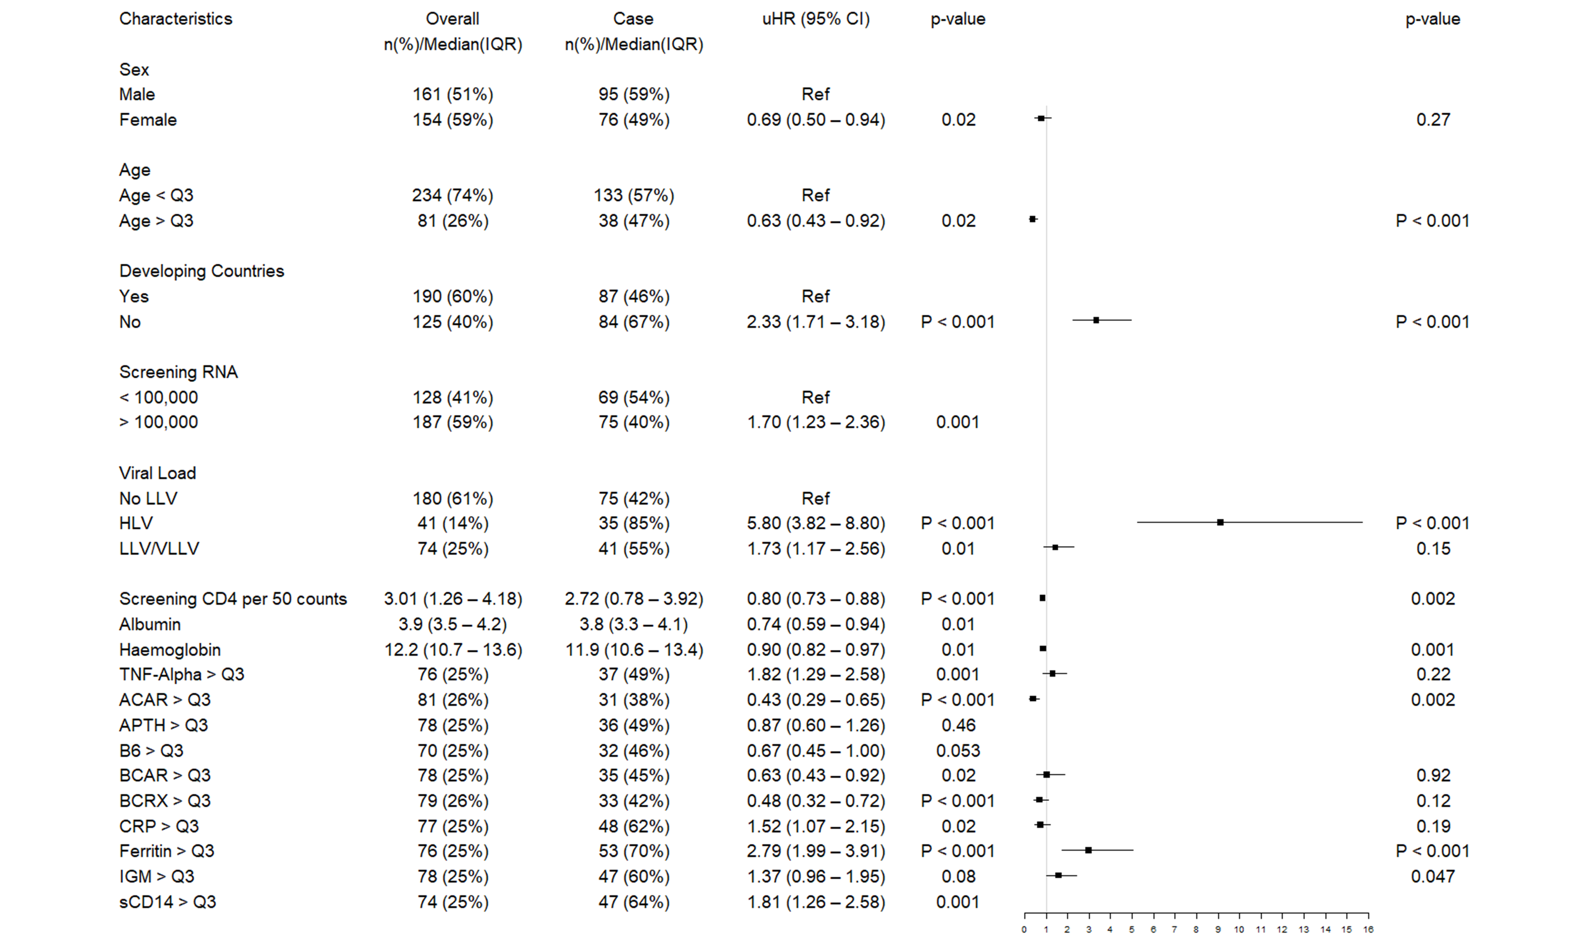
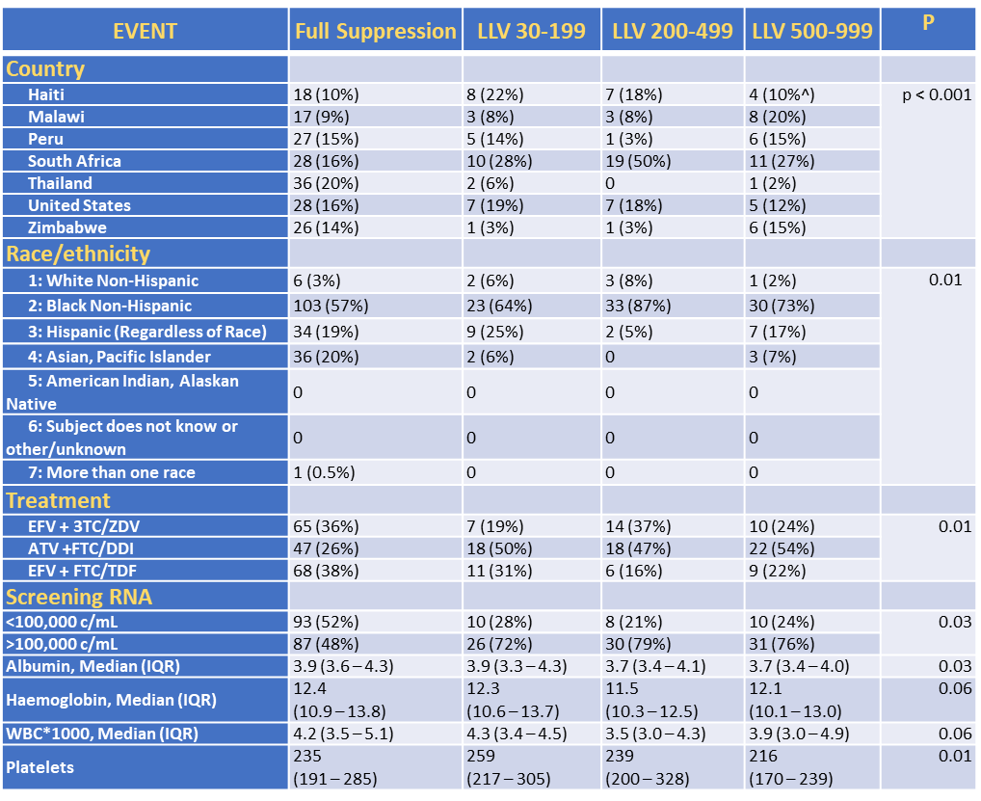

Evaluation of low-level viremia in a multinational study and associations with clinical outcomes, immunologic outcomes and micronutrients
H. Dunlevy¹, M. Dsouza², N. Gupte³, K. Harrington², S. Badal-Faesen⁴, S. Pillay⁵, M. Hosseinipour⁶, S. Berendes⁷, K. Supparatpinyo⁸, C. Riviere⁹, J. Lama¹⁰, J. Hakim¹¹, R. Rapaport¹², D. Asthmus¹³, A. Balagopal³, A. Gupta³, T. Campbell¹, ACTG PEARLS and NWCS 319 study teams
¹University of Colorado, Internal Medicine, Division of Infectious Diseases, Aurora, United States, ²Hologic, Inc., San Diego, United States, ³Johns Hopkins University, Baltimore, United States, ⁴University of Witwatersrand, Johannesburg, South Africa, ⁵University of KwaZulu-Natal, Durban, South Africa, ⁶University of North Carolina, Chapel Hill, United States, ⁷London School of Hygiene and Tropical Medicine, London, United Kingdom, ⁸Chiang Mai University, Chiang Mai, Thailand, ⁹Haitian Group for the Study of Kaposi’s Sarcoma and Opportunistic Infections, Port-au-Prince, Haiti, ¹⁰Asociacion Civil Impacta Salud y Educacion, Lima, Peru, ¹¹University of Zimbabwe College of Health Sciences, Harare, Zimbabwe, ¹²University of Colorado, Aurora, United States, ¹³UC Davis, Sacramento, United States.
Background:
EVENT | Full Suppression | LLV 30-199 | LLV 200-499 | LLV 500-999 | P
INF-Gamma | 23.9 (7.8 – 61.4) | 43.0 (22.4 – 111.7) | 23.0 (12.7 – 77.8) | 21.4 (4.6 – 82.3) | 0.03
IP-10 | 1059 (530 – 2482) | 1872 (1000 – 3831) | 2856 (1751 – 4442) | 1267 (572 – 3351) | < 0.001
TNF-Alpha | 17.7 (12.0 – 26.0) | 21.1 (17.1 – 32.3) | 23.7 (13.9 – 33.8) | 24.7 (14.7 – 38.5) | 0.004
BCAR | 0.24 (0.13 – 0.42) | 0.17 (0.09 – 0.29) | 0.17 (0.10 – 0.30) | 0.28 (0.15 – 0.44) | 0.07
BCRX | 0.08 (0.04 – 0.15) | 0.05 (0.04 – 0.11) | 0.06 (0.04 – 0.08) | 0.06 (0.03 – 0.10) | 0.08
LUT | 0.18 (0.12 – 0.30) | 0.17 (0.11 – 0.31) | 0.15 (0.09 – 0.21) | 0.24 (0.15 – 0.38) | 0.02
sCD14x10⁵ | 20 (5.1 – 27) | 20 (7.1 – 26) | 25 (18 – 32) | 17.5 (5.1 – 27) | 0.05
Results Summary:
PEARLS (ACTG A5175) was a randomized clinical trial to evaluate the efficacy of three antiretroviral regimens in low-, middle- and high-income countries in Africa, Asia, North and South America.
Plasma HIV-1 RNA (VL) was measured using Aptima HIV-1 Quant Dx in stored specimens from a subset of PEARLS participants and investigated significance of low-level viremia (LLV) after ART initiation.
Methods:
Analysis using plasma and data from 315 individuals previously selected for a case-cohort study of immunologic and micronutrient outcomes in PEARLS.
VL measured every 3 months after ART initiation. Repeat analysis performed for available samples using Aptima HIV-1 Quant Dx on the Panther instrument system (Hologic, San Diego, CA).
Participants categorized by VL 16 wks or later after ART:
  Never suppressed (NS): VL >1000 c/mL consistently
  Virologic rebound (VR): VL >1000 c/mL on two consecutive occasions after meeting other LLV or FS category
  LLV 30-199: VL in this range on two consecutive occasions
  LLV 200-499: VL in this range on two consecutive occasions
  LLV 500-999: LLV on two consecutive occasions with at least one is in this range
  Full suppression (FS): No more than one consecutive measurement with VL >30 c/mL.
  Composite outcome: WHO stage 3 or 4 event, death, virologic rebound, immunologic failure
  Immunologic failure: CD4 <100 cells/microliter at 48 weeks.
Cox regression models estimated hazards for composite endpoint of WHO stage 3/4 event, death, virologic rebound and immunologic failure and secondary endpoint of subsequent VR.
LLV 30-499
LLV 500-999
Full Suppression
Characteristics associated with composite endpoint
Univariable HR 95% CI
Multivariable HR 95% CI
Hazard Ratios effect of LLV on composite outcome
Results:
 | Unadjusted HR (95% CI) | P | Adjusted HR* (95% CI) | P
Full Suppression LLV: 30 - 499 LLV: 500 – 999 | Ref 1.73 (1.17 – 2.56) 5.80 (3.82 – 8.80) | 0.01 < 0.001 | Ref 2.04 (1.36 – 3.06) 5.92 (3.82 – 9.19) | 0.001 p < 0.001
* Multivariable model adjusted for age, gender, BMI, Treatment, Screening CD4
LLV was associated with the following baseline characteristics: country, race/ethnicity, randomized study treatment, higher entry viral load, lower serum albumin, lower platelets, higher IP-10 (interferon gamma induced protein 10), higher TNFα and lutein.
In multivariable analysis of the composite outcome, participants with LLV 30-499 c/mL and LLV 500-999 c/mL had increased HR of subsequent WHO endpoint (aHR 2.04; 95% CI 1.36-3.06; and aHR 5.92; 95% CI 3.82-9.19, respectively). LLV at both 30-499 and 500-999 c/mL had increased hazards of subsequent VR (aHR 8.4; 95% CI 4.0-17.4; and aHR 31.6, 95% CI 14.5-69.1,respectively).
Every increase in CD4 by 50 cells leads to 20% decrease in unfavorable outcome.
Hazard Ratios effect of LLV on virologic rebound
Conclusions:
 | Unadjusted HR (95% CI) | P | Adjusted HR* (95% CI) | P
Full Suppression LLV: 30 - 499 LLV: 500 - 999 | Ref 7.3 (3.8 – 14.1) 23.5 (12.1 – 45.3) | < 0.001 < 0.001 | Ref 8.4 (4.0 – 17.4) 31.6 (14.5 – 69.1) | < 0.001 < 0.001
* Multivariable model adjusted for age, gender, BMI, Treatment, Screening CD4 & baseline VL (Aptima)
Across diverse multinational settings, LLV at 16 weeks or later after ART initiation was associated with having a subsequent WHO stage 3 or 4, virologic rebound, immunologic failure or death. These findings reinforce the importance of frequent viral load monitoring with a sensitive assay in these settings early post-ART initiation.
PRESENTED AT THE 23RD INTERNATIONAL AIDS CONFERENCE (AIDS 2020) | 6-10 JULY 2020

